Slide 1
Visualizations of MOMS-PI Microbiome Data Russ Wolfinger, Director of Scientific Discovery and Genomics, JMP, LLC See Notes for commentary on each plot.

Slide 2
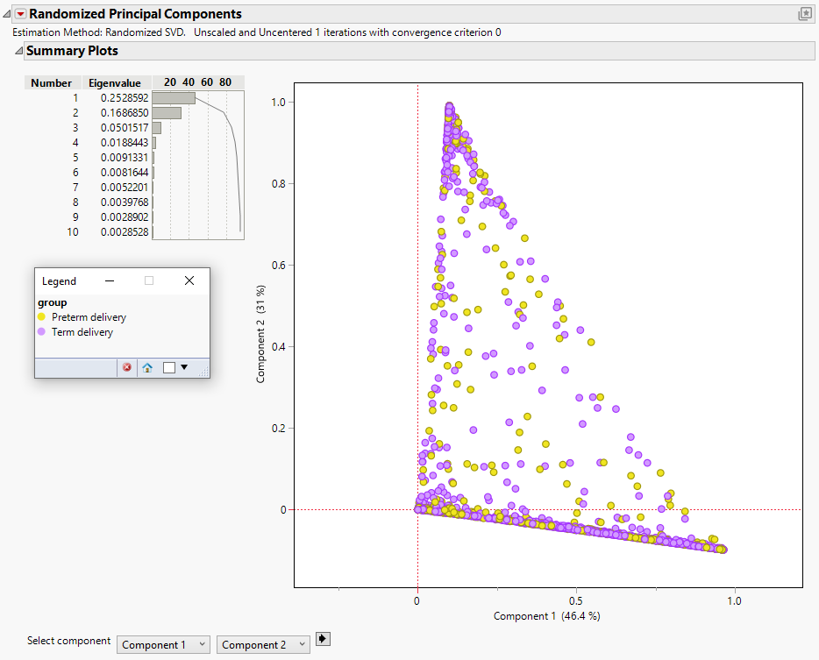
Notes:
A randomized PCA on unstandardized relative abundances. The first two components already explain over 80% of the variability, as also evidenced by the large number of points on the border of the triangular bounding frame. The plot reveals no clear separation between preterm and term deliveries.

Slide 3
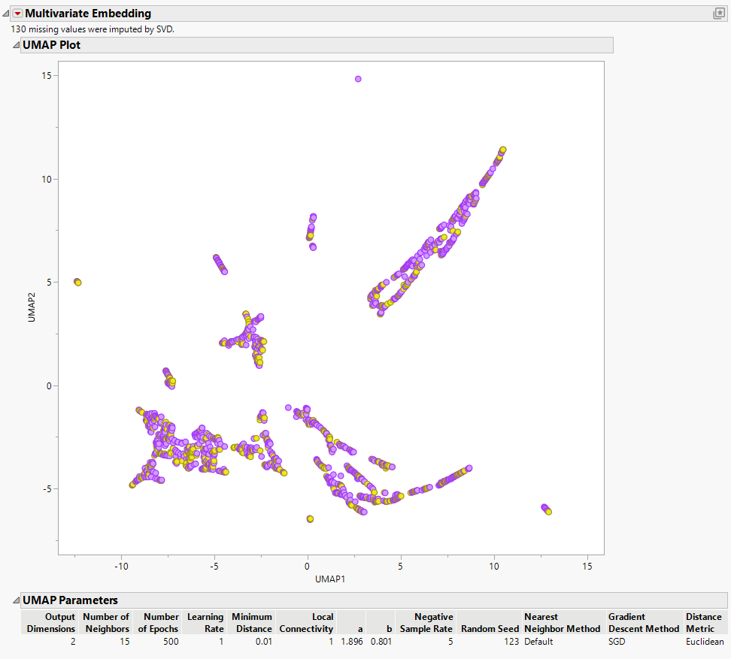
Notes:
This is a UMAP projection of the first 10 principal components. It reveals some interesting clusters of moms, but again, no clear groupings of preterm and term.

Slide 4
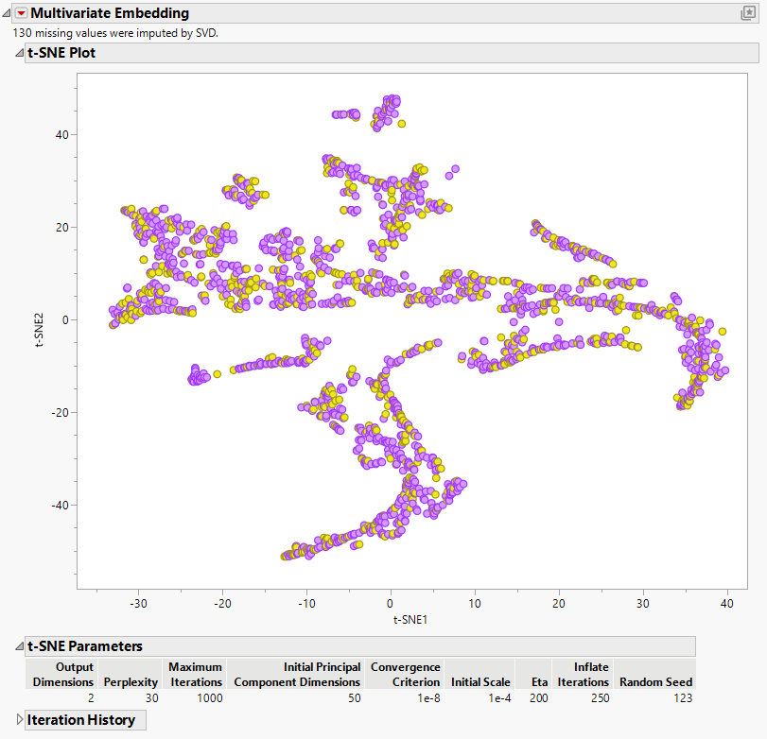
Notes:
T-SNE plot, with similar story as UMAP.

Slide 5
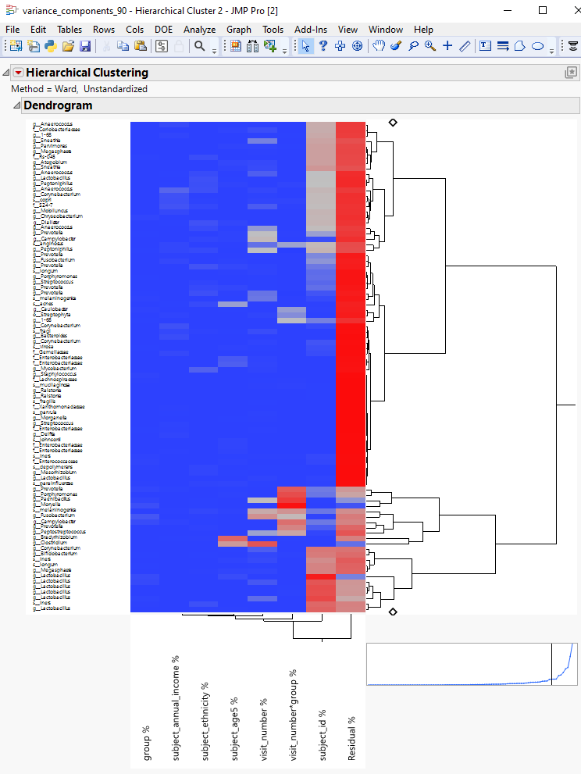
Notes:
We fit a variance components model to the top 90 most abundant Operational Toxonomic Units (OTUs) to quantitatively assess sources of variability for each. The heatmap colors correspond to proportion of variability explained by each effect. “Residual %” reflects unexplained variability, which is the largest effect for most OTUs. The highlighted region reveals several OTUs with a large visit_number by group interaction, which are ones associated with preterm and term differences over time.

Slide 6
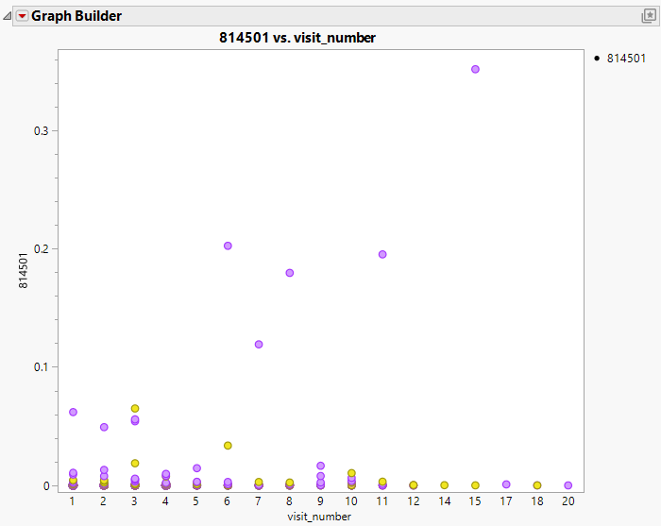
Notes:
This highlights one OTU from the previous analysis. Higher proportions of this one appear to be favorably associated with full term births.

Slide 7
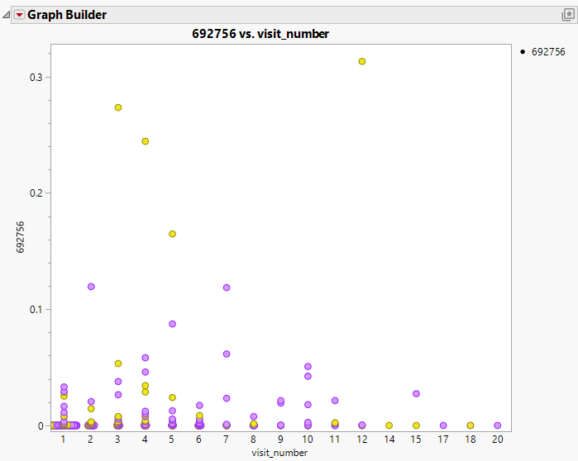
Notes:
Another OTU from the variance components analysis, but this one appears to be associated with pre-term birth.

